Slide 1

Streamlining Aviation Operations with Precision
Flight Management System
Made by :ALI RAZA
REG # FA22-BSE-116
Photo by Pexels

Slide 2
Table of Contents
01
Introduction
02
Key Features
03
Architecture and Models
04
Workflow
05
Challenges and Solutions
06
07
Conclusion and Future Scope
Screen shots of actual project

Slide 3

1
Introduction
Web-Based System
A web-based system to manage flights and passenger bookings, aiming to simplify operations for administrators and enhance user experience for customers.
A web-based system simplifying flight and passenger management, with a focus on operational efficiency and user satisfaction.
Streamlines flight and passenger management processes through digital solutions for enhanced operational efficiency and customer satisfaction.
A comprehensive digital tool enhancing aviation operations by streamlining flight and passenger management processes.
Photo by Pexels

Slide 4
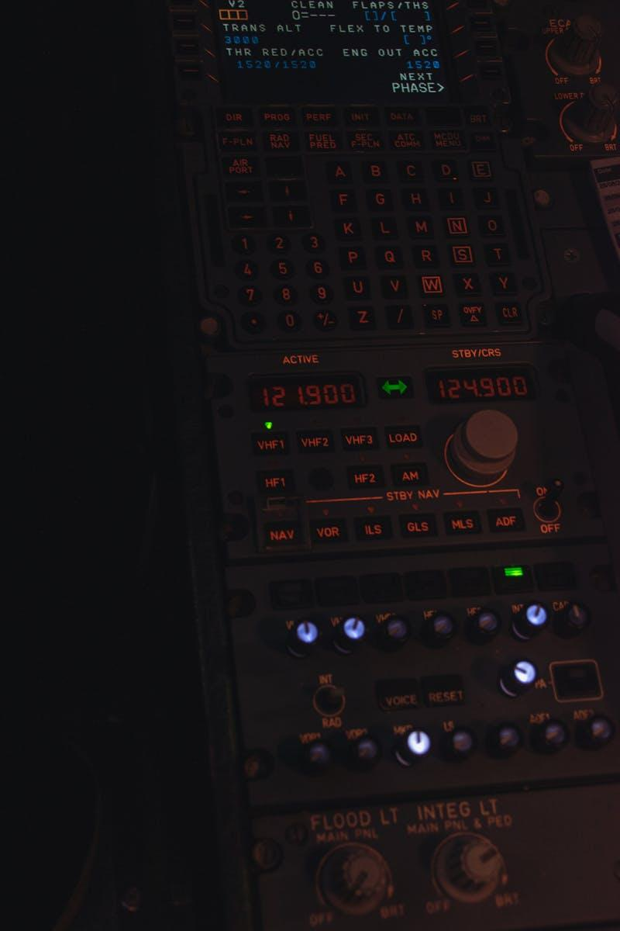
2
Key Features
Admin & Customer Features
Admin capabilities include managing flights and schedules, viewing passenger lists, and generating reports. Customer features involve booking flights, managing bookings, and accessing flight details and schedules.
Admins can efficiently handle flight operations and insights while customers can conveniently book flights and manage their reservations with detailed information at their disposal.
Enables admins to oversee flight operations and generate reports, and empowers customers with seamless flight booking and management experiences.
Provides administrators with tools to manage flight operations and passenger data, while offering customers an intuitive platform for booking and managing flights.
Photo by Pexels

Slide 5

3
Architecture and Models
System Components
Backend built with Django, frontend utilizes HTML, CSS, JavaScript, and the database incorporates SQLite/MySQL. Key models include User (Admin, Customer), Flight (destination, capacity), Booking (reservations), Passenger (details), and Report (insights).
System architecture involves Django backend, HTML/CSS/JavaScript frontend, and SQLite/MySQL database. Key models include User (with roles), Flight (details), Booking (reservations), Passenger (specific data), and Report (operational insights).
Utilizes Django for backend, HTML/CSS/JavaScript for frontend, and SQLite/MySQL for the database. Key models include User (with roles), Flight (details and capacity), Booking (user reservations), Passenger (specific data), and Report (operational insights).
Employs Django for backend, HTML/CSS/JavaScript for frontend, and SQLite/MySQL for the database. Key models include User (roles), Flight (destination and capacity), Booking (reservations), Passenger (specific data), and Report (insights).
Photo by Pexels

Slide 6

4
Workflow
Customer and Admin Processes
Customer workflow includes registering/logging in, searching/booking flights, and managing bookings. Admin workflow involves managing flights/schedules, viewing passenger lists, and generating reports.
Customers go through a seamless process of registering, booking, and managing their flights. Admins efficiently handle flight operations, passenger details, and reporting.
Guides customers through flight booking and management steps, and assists admins in managing flight operations, passenger details, and generating reports.
Navigates customers through flight booking and management processes, and assists admins in effectively managing flight operations and passenger details.
Photo by Pexels

Slide 7

5
Challenges and Solutions
Overcoming Hurdles
Challenges include implementing custom user roles, ensuring data integrity, and scalability. Solutions involve using Django's authentication for roles and applying database validations/constraints.
Challenges encompass custom user roles, data integrity, and scalability. Solutions include Django's role-based authentication and database integrity measures.
Faces challenges adapting custom user roles, maintaining data integrity, and scalability. Solutions incorporate Django's role-based authentication and database integrity practices.
Tackles challenges related to user roles, data integrity, and scalability. Implements solutions through Django's authentication for roles and database integrity measures.
Photo by Pexels

Slide 8

6
Conclusion and Future Scope
Summary and Development
Conclusion highlights an efficient, scalable flight management solution that simplifies administrative and customer operations. Future scope includes mobile app development, real-time flight updates, and enhanced analytics for reporting.
Concludes with an efficient and scalable flight management solution that enhances operations for both administrators and customers. Future plans encompass mobile app development and advanced reporting analytics.
Summarizes an efficient flight management solution that streamlines operations for admins and customers. Future possibilities include mobile app integration and advanced reporting features.
Wraps up with an efficient flight management solution benefiting admins and customers alike. Future advancements include mobile app integration and improved reporting capabilities.
Photo by Pexels

Slide 9

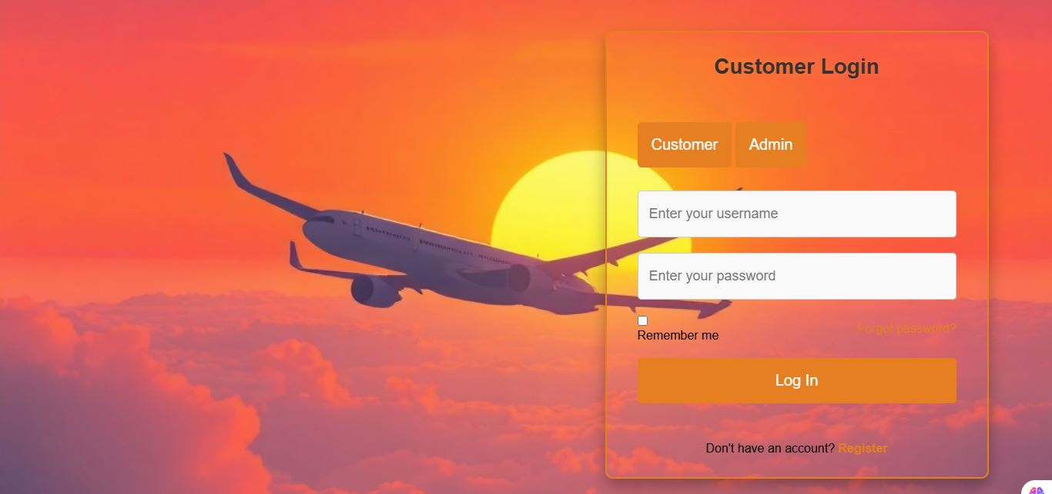
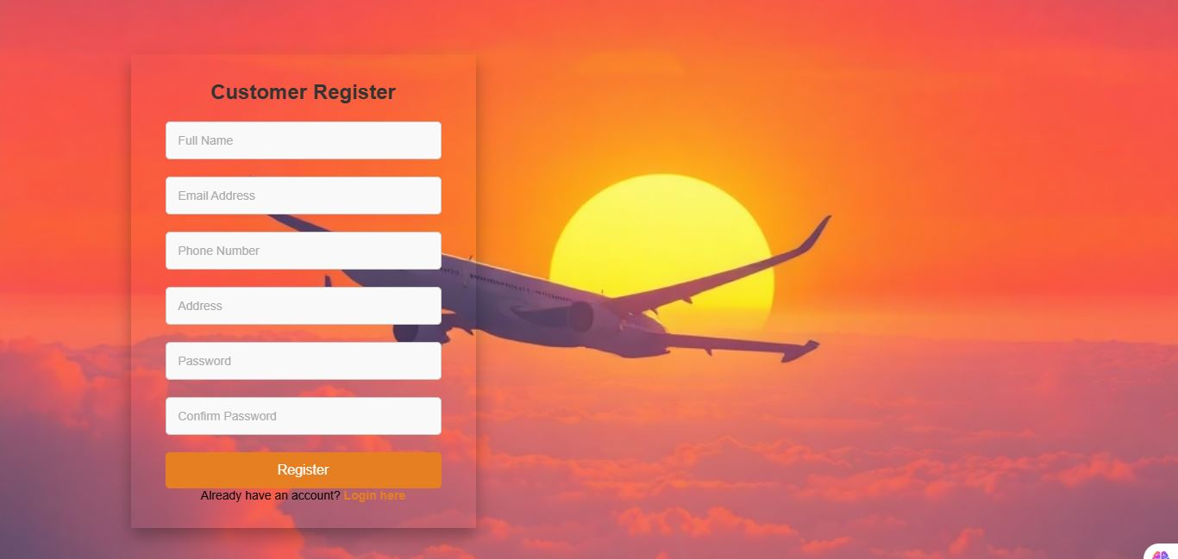

Slide 10
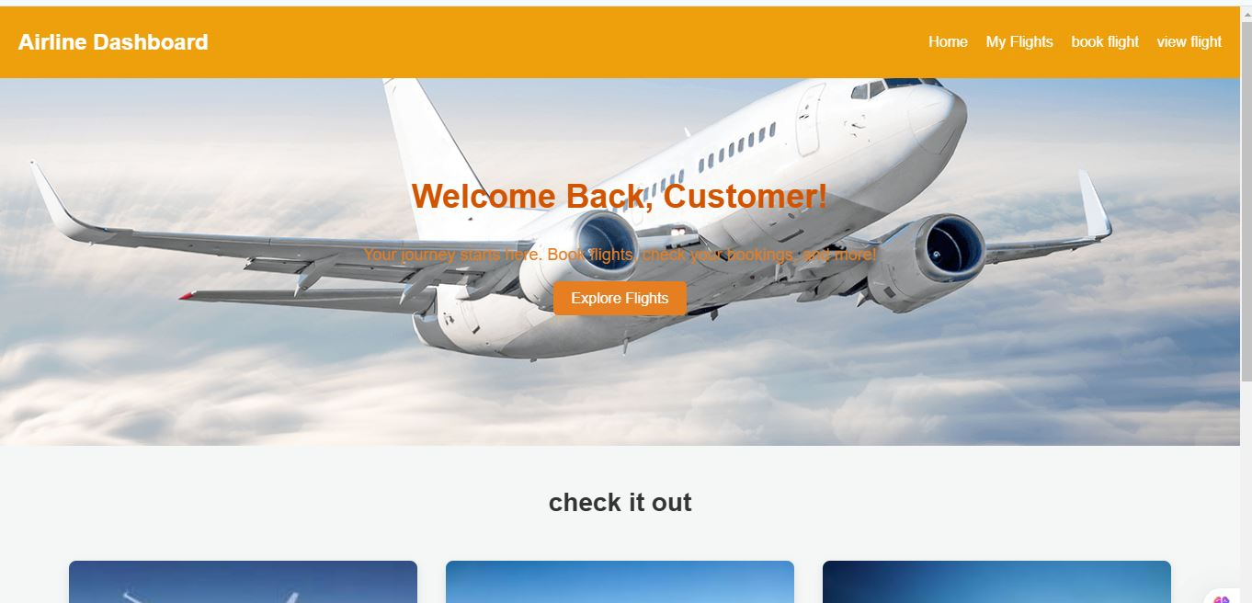
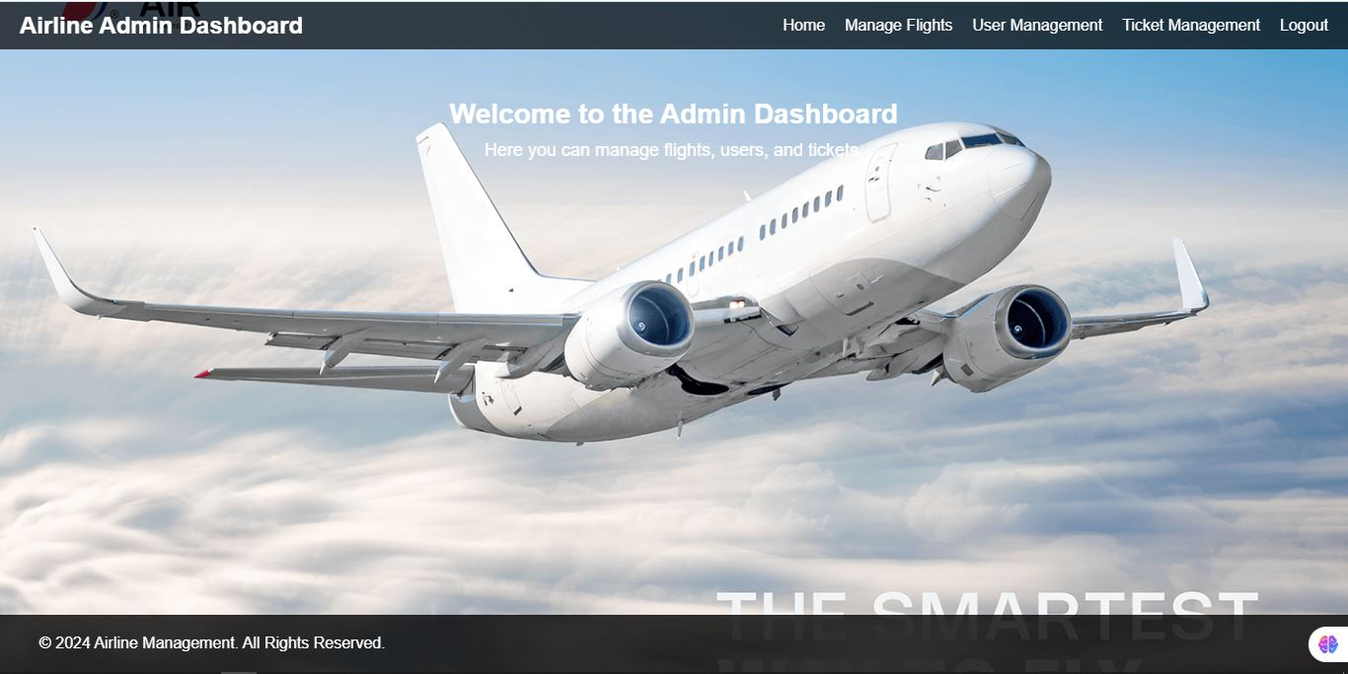

Slide 11
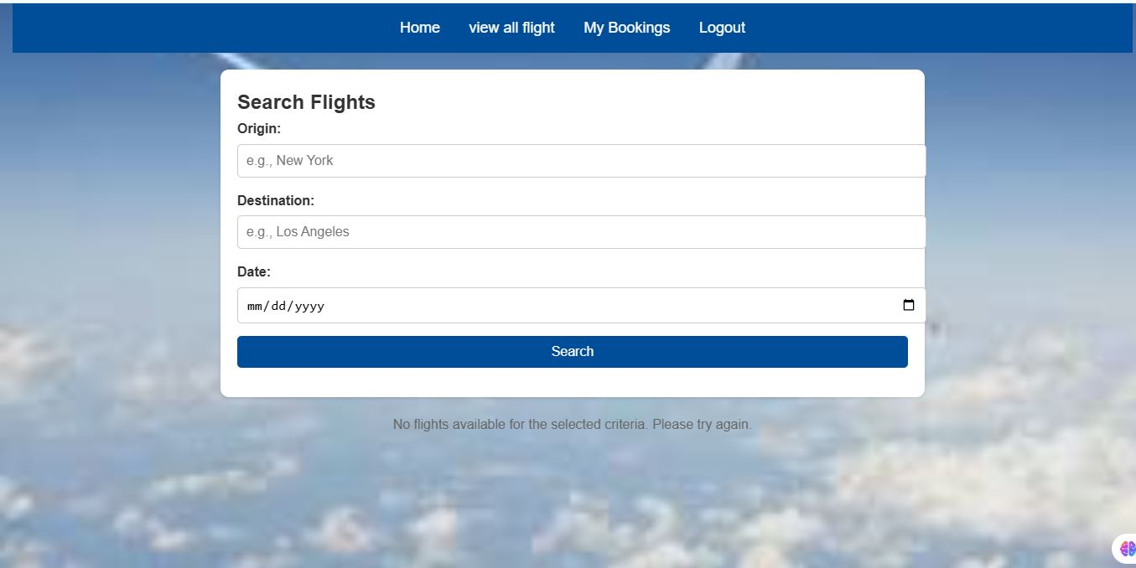
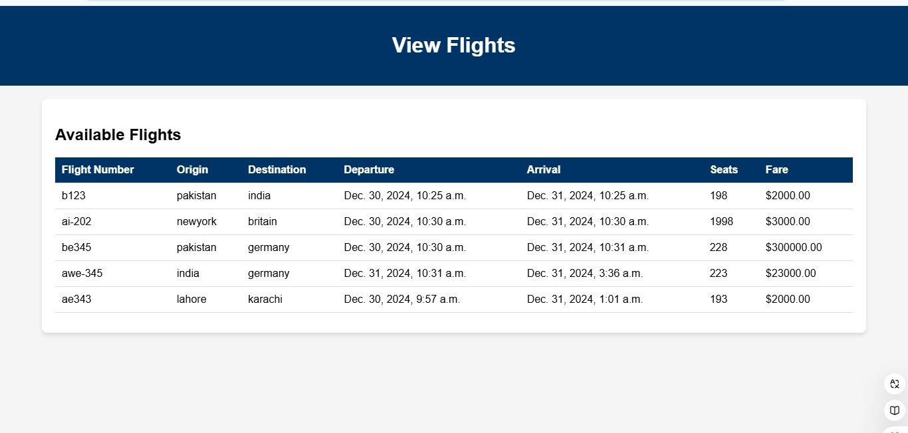

Slide 12
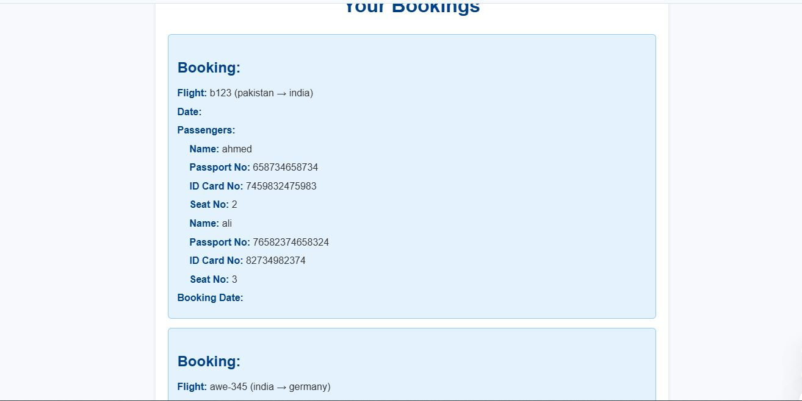

Slide 13
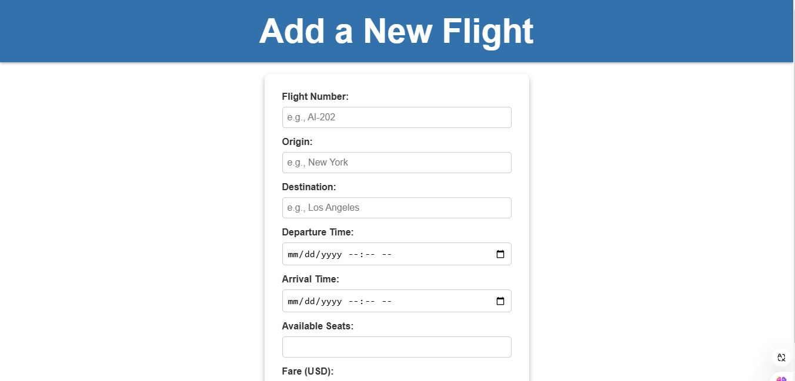
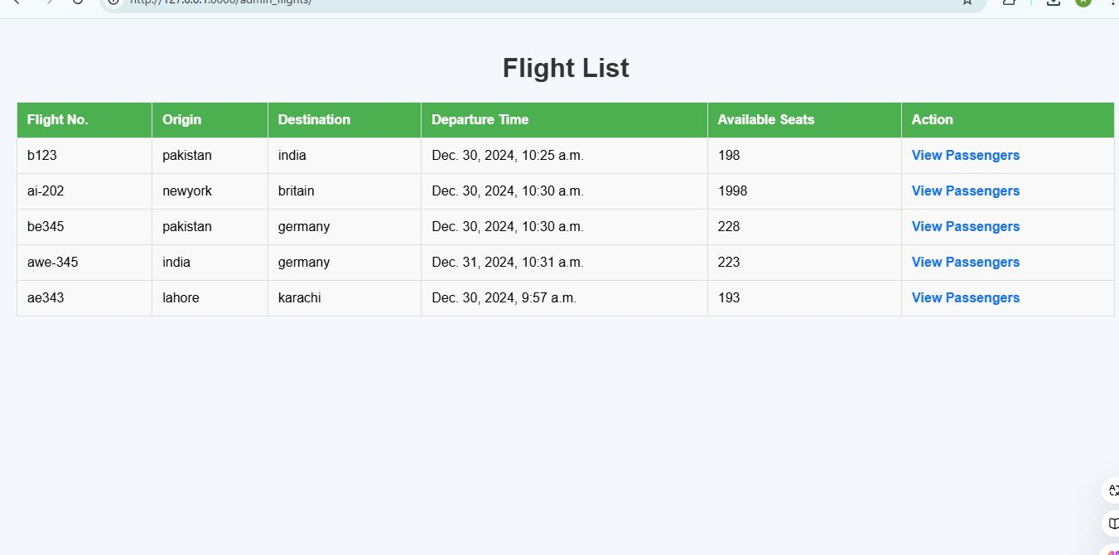

Slide 14
